Slide 1
Comparison & Negation
Based on parts from LPN chapters 9 and 10

Slide 2
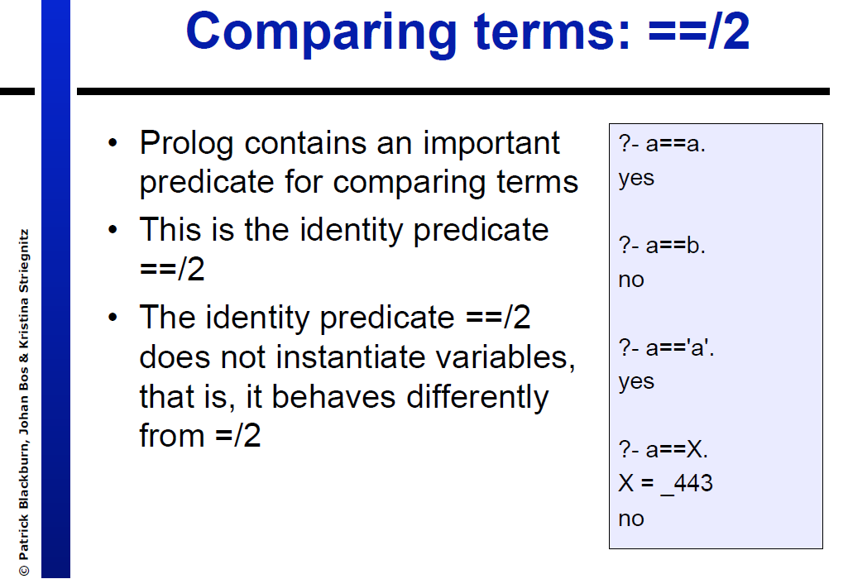

Slide 3
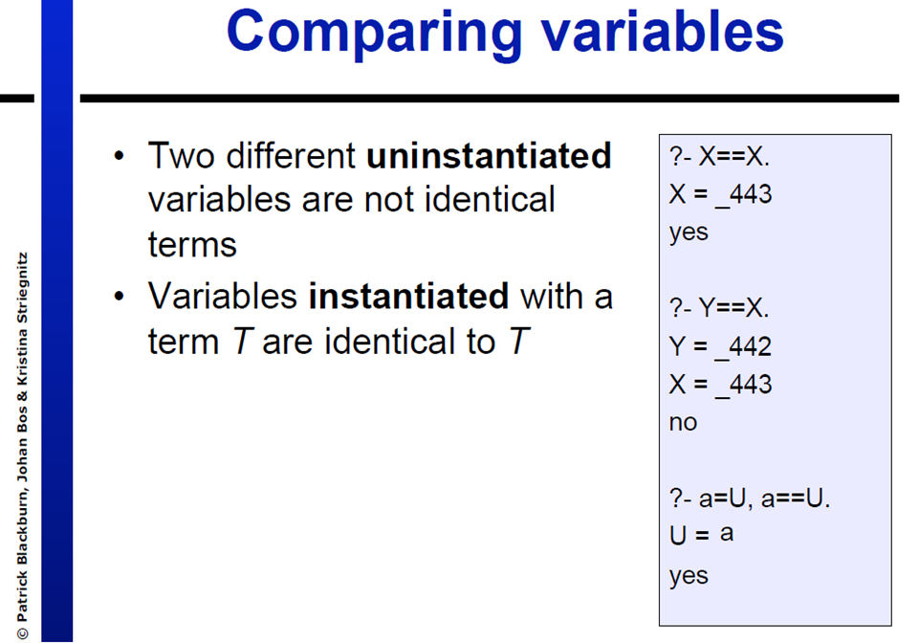

Slide 4
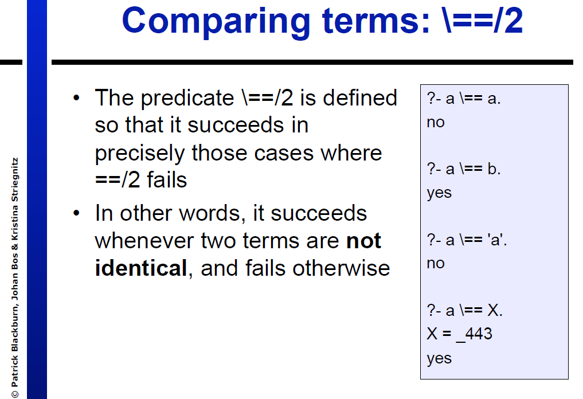

Slide 5
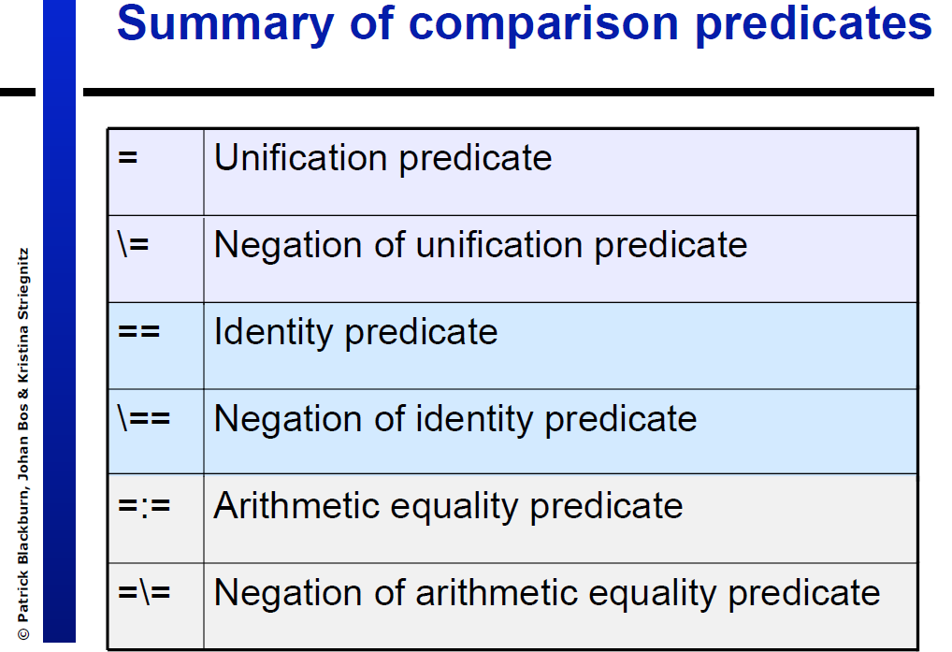

Slide 6
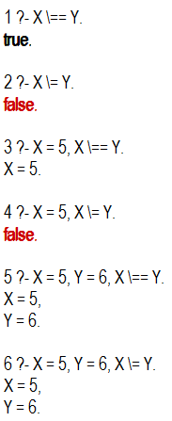

\== vs. \=
When are those two predicates different, when we compare X and Y?
If they are both instantiated \== and \= will return the same answer
If at least one (say Y) isn’t instantiated:
X \= Y will fail because nothing prevents Y from instantiating to X in the future
X \== Y will succeed because they are currently not the same
Always use comparisons after the variables have been instantiated
For \= it does not make sense otherwise
For \== consider this:

Slide 7
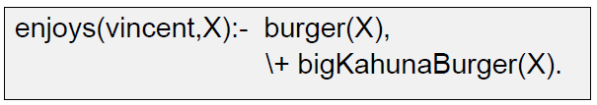
Negation in Prolog
Sometimes we’ll need to use negation of predicates, not only negation of identity/unification
Example: how do we define that Vincent enjoys all types of burgers except for big kahuna burger?
\+ is the negation as failure predicate
Prolog tries to satisfy bigKahunaBurger(X), and if it fails then \+bigKahunaBurger(X) succeeds.

Slide 8
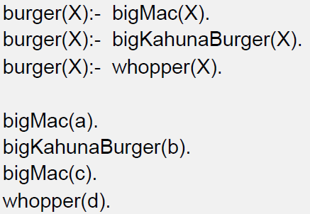
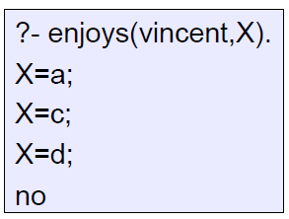
Negation in Prolog (2)
With the following knowledgebase, what would be the output of ?-enjoys(vincent,X)?

Slide 9


Prolog vs. Logical Negation
Is Prolog’s negation the same as logical negation (not)?
Declaratively they are the same: we simply translated the logical rule that Vincent loves all types of burgers except for big kahuna into prolog syntax
Procedurally we won’t always get the same result, therefore negation as failure is not logical negation
What happens if we change the rule’s goals order?
Prolog first tries to satisfy bigKahunaBurger(X), it finds X=b, and then \+bigKahunaBurger(X) fails.
We should always use \+ on predicates with variables that have already been instantiated

